Slide 1

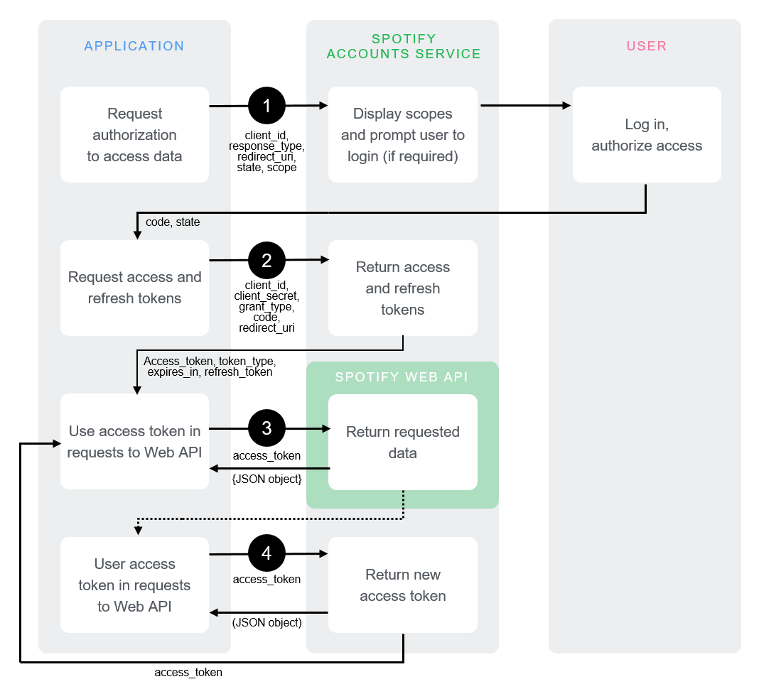
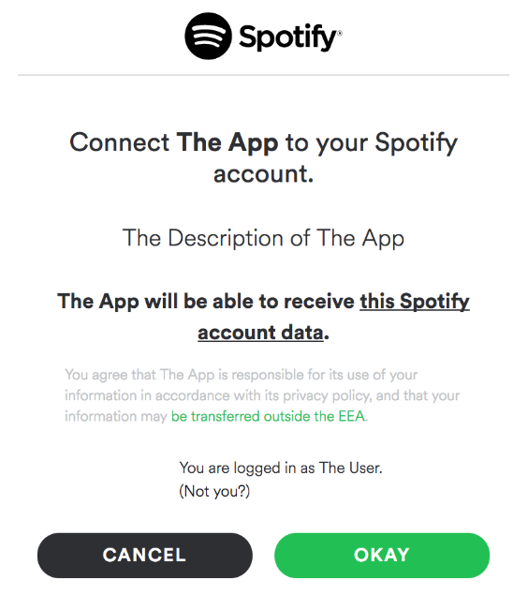
https://accounts.spotify.com/authorize?client_id=5fe01282e44241328a84e7c5cc169165&response_type=code&redirect_uri=https://localhost&scope=user-read-private

Slide 2
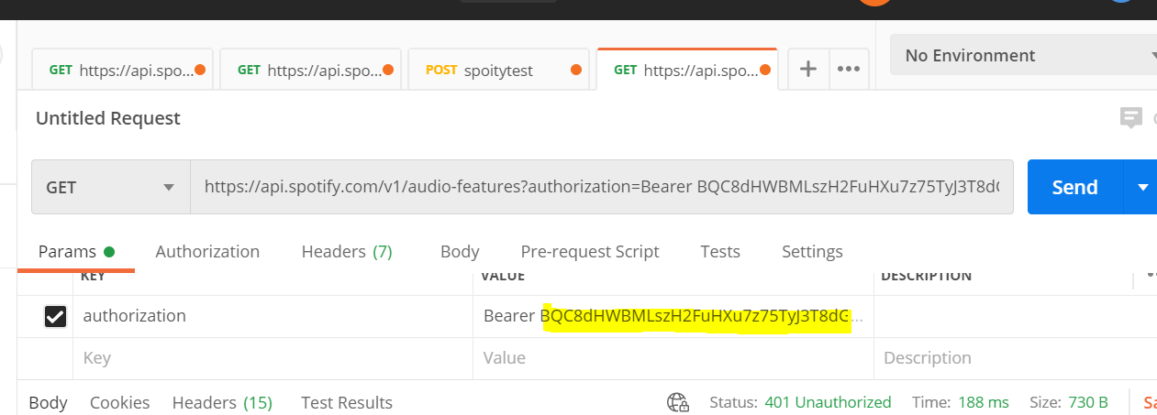
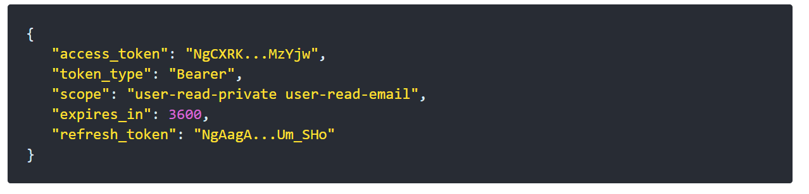

Slide 3
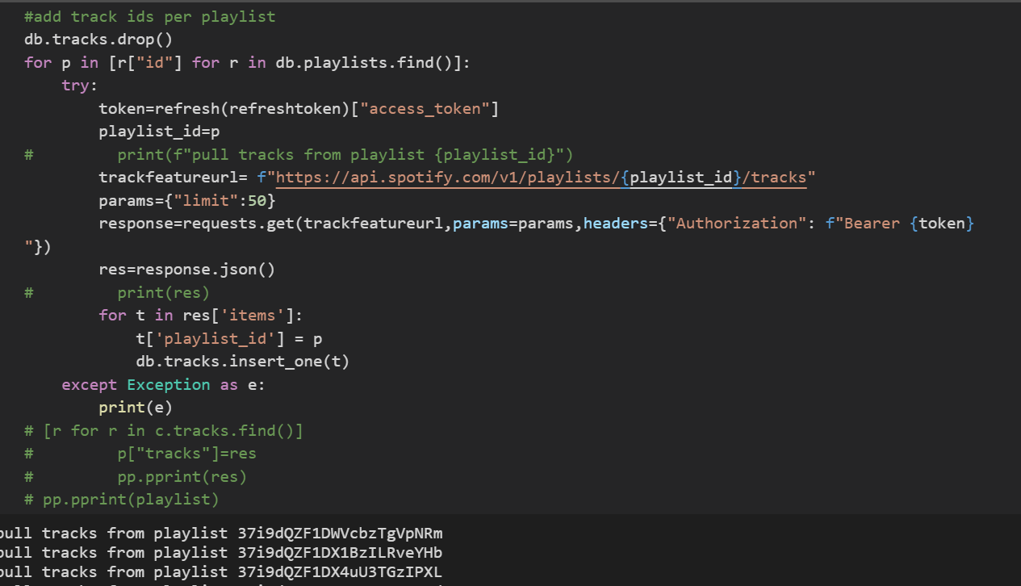
Category:
Name/ID
Playlists:
Category/Playlist ID
Tracks:
Playlist/Track ID
Audio Feature:
Tracks/Audio features

Slide 4
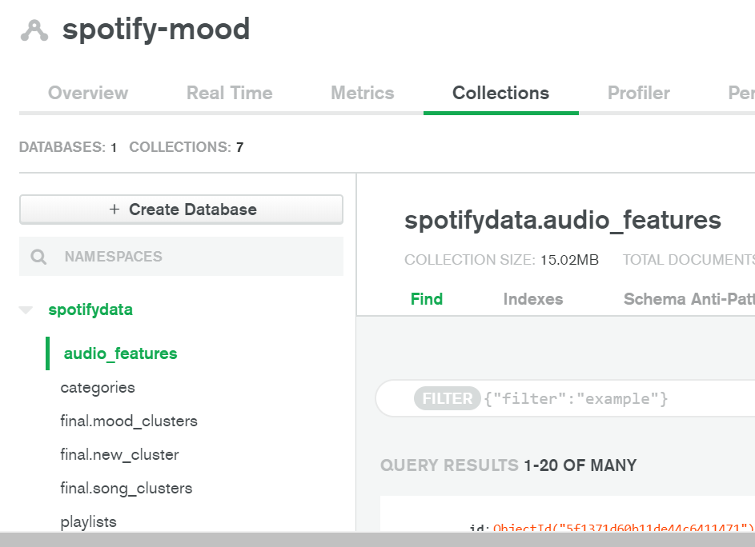
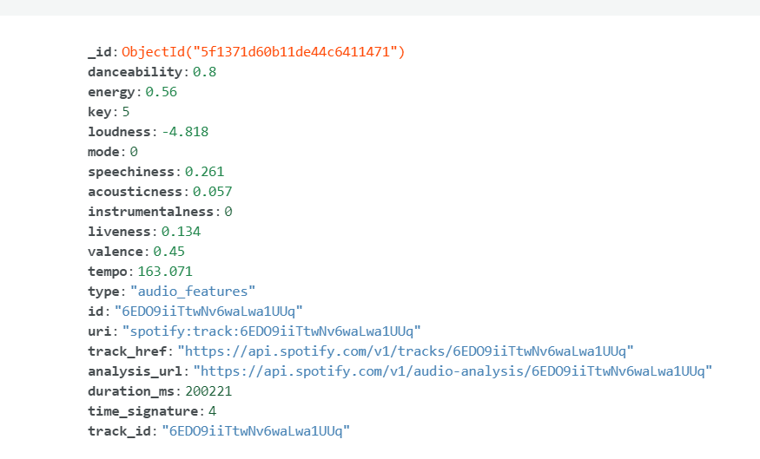

Slide 5
